Slide 1





Machine Learning Project
Forecasting Debt Collection Trends

Slide 2


About the Title
The project aims to develop a machine learning model to predict the probability of successfully collecting debts by analyzing statute-barred status. Using features like balances, purchase price, debt type, and more, the goal is to identify accounts where statute-barred status impacts recovery likelihood.

Slide 3
KEY PROBLEM
The key problem is identifying which accounts in debt collection are statute-barred and, as a result, may not be recoverable. Specifically, the goal is to predict the likelihood of successfully collecting a debt based on the statute-barred status of each account. The challenge lies in analyzing a range of features—such as account balances, creditor information, purchase dates, etc.—and determining whether an account’s statute-barred status significantly impacts its collectability.
WHY IS SOLVING THIS PROBLEM IMPORTANT?
Solving this problem is crucial because identifying statute-barred accounts early can help debt collectors avoid wasting resources on accounts that are unlikely to generate recovery. This leads to improved efficiency in debt collection processes, ensuring that efforts are focused on accounts with a higher probability of successful collection. Additionally, accurately predicting which debts are recoverable can help organizations minimize losses, optimize collections strategies, and enhance overall financial health.
Problem Statement
PRACTICAL RELEVANCE
This problem is highly relevant in the financial services industry, particularly within debt collection agencies, banks, and credit institutions. It also has a significant impact on industries dealing with high volumes of outstanding debt, such as telecommunications, utilities, and consumer finance. By utilizing machine learning, these organisations can automate and streamline their decision-making process, making more informed choices about where to invest resources and which debts to prioritise. Furthermore, it plays a crucial role in regulatory compliance, as certain debts might have legal limitations on collection, affecting financial institutions' legal obligations.

Slide 4
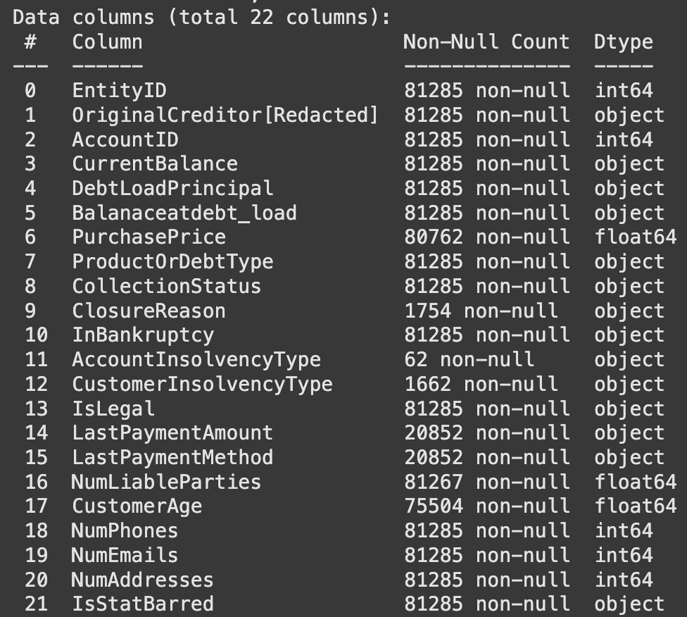
DATA STRUCTURE
BIFURCATION ON THE FEATURES ON BASIS OF DATA TYPE
Rows- 81285(20%)
Columns- 22
Numerical Columns- 8
Categorical Columns- 13
Target Variable- 1
About the Dataset
20% of data is selected for faster processing as dataset is large

Slide 5
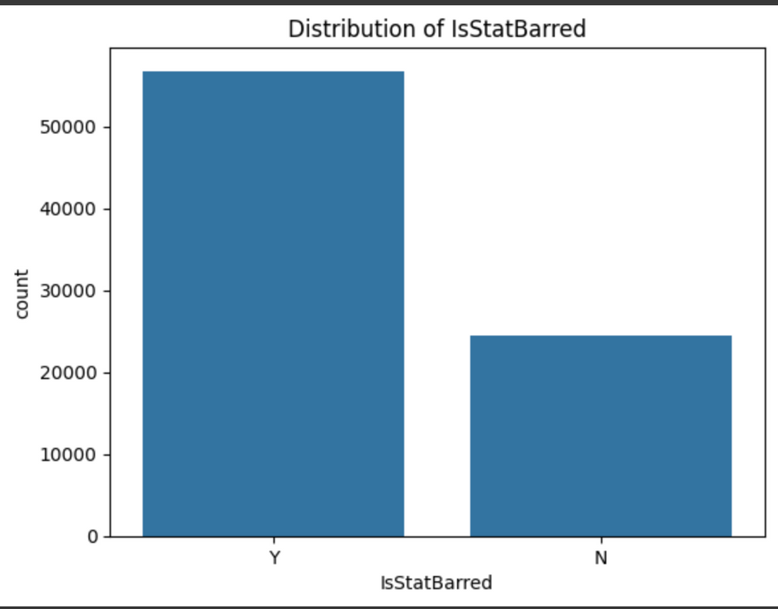
TARGET VARIABLE
TARGET VARIABLE CLASSES
IsStatBarred
Y - 56777 (70%)
N - 24508 (30%)
DESCRIPTION
Target variable has 2 class
- Y mean unbarred
- N means unbarred
We can clearly see there is a class imbalance as 70% of the values belongs to class ‘Y’ and 30% to class ‘N’
About the Target Variable

Slide 6


EDA,
Feature Engineering
And
Data Preprocessing
Approaches

Slide 7
CATEGORICAL FEATURES
APPROACH USED FOR FEATURE SELECTION
CurrentBalance
DebtLoadPrincipal
Balanaceatdebt_load
ProductOrDebtType
CollectionStatus
ClosureReason
InBankruptcy
AccountInsolvencyType
CustomerInsolvencyType
IsLegal
LastPaymentAmount
LastPaymentMethod
Check Missing Value if more than 90% of the values are missing, drop the feature else use imputation techniques to handle missing values.
Imputation techniques used are:
- Random Sample Imputation
- KNN Imputation
Observe the count plot with target variable and based upon the diverse disribution select the feature.
Categorical Feature Approach
SELECTED FEATURES
DROPPED FEATURES
CurrentBalance
DebtLoadPrincipal
Balanaceatdebt_load
ProductOrDebtType
CollectionStatus
InBankruptcy
IsLegal
LastPaymentAmount
LastPaymentMethod
ClosureReason
AccountInsolvencyType
CustomerInsolvencyType
REASON FOR DROP
Every feature has more than 95% missing value
REASON FOR SELECTION
TOTAL FEATURES SELECTED
Every column should diverse distribution with both the classes of target varaible
So out of 12 features 9 are selected for model building

Slide 8
NUMERICAL FEATURES
APPROACH USED FOR FEATURE SELECTION
PurchasePrice
NumLiableParties
CustomerAge
NumPhones
NumEmails
NumAddresses
Check Missing Value if more than 90% of the values are missing, drop the feature else use imputation techniques to handle missing values.
Check the individual distribution with KDE plot to select the imputation techniques to fill missing values.
Imputation techniques used is Median Imputation as most of the individual distributions are right skewed
Additionally for feature CustomerAge for negative age, absolute values are used and then ages which are less than 20 are replace with median and missing values are also filled with median
Relationship with target variable has been observe using 3 things:
- BOX PLOT
- HISTOGRAM
- CORRELATION
Based upon the combine observation of all 3 properties feature selection is done.
SELECTED FEATURES
PurchasePrice
CustomerAge
NumPhones
NumEmails
Numerical Feature Approach
REASON FOR SELECTION
Clear distinction and highlighed different distribution between 2 categories of target variable in box plot and good histogram
Moderate correlation with target.
DROPPED FEATURES
NumLiableParties
NumAddresses
REASON FOR DROP
TOTAL FEATURES SELECTED
Similar distinction and distribution in box plot and histogram between both categories of target variable.
Week Correlation with target.
So out of 6 features, 4 are selected for model building

Slide 9
FOLLOWING ARE THE 14 FEATURES SELECTED FOR MODEL BUILDING INCLUDING 1 TARGET VARIABLE
CurrentBalance
DebtLoadPrincipal
Balanaceatdebt_load
ProductOrDebtType
CollectionStatus
InBankruptcy
IsLegal
LastPaymentAmount
LastPaymentMethod
PurchasePrice
CustomerAge
NumPhones
NumEmails
IsStatBarred (Target)
Selected Features for Model Building

Slide 10

Model Building

Slide 11
ENCODING
APPROACH
Label Encode to maintain the same feature count and avoid adding more feature that makes the model more complex by increasing its dimension
Firstly train the models individually on the given dataset (imbalanced) and evaluate their performance.
For Evaluation ACCURACY and ROC_AUC_SCORE metrics are used because on an imbalanced data, accuracy alone is not reliable measure as it may get biased towards the majority class, where as ROC_AUC score is generally a better evaluation metric than accuracy because it evaluates the model's ability to distinguish between the classes without being biased by class imbalances.
Once the evaluation is done then use different techniques to improve the model performance.
Techniques which are used to improve performance are:
- Ensemble technique(Stacking)
- Hyper Parameter Tuning using
GridSearchCV.
- SMOTE to handle imbalance date
and applying it to each model and
evaluate their performance before
SMOTE and after SMOTE.
Give the final conclusion after applying all the technique and observing the results.
FEATURE SCALING
Standard Scaler is used for feature scaling
Model Building Approach
TRAIN AND TEST SPLIT RATIO
Train- 80%
Test- 20%
MODEL USED
Logistic Regression
SVM
Naive Bayes
Random Forest
Adaboost
Gradient Boosting

Slide 12
Model Performance on Imbalance Data
LOGISTIC REGRESSION
SVM
NAIVE BAYES
ADABOOST
RANDOM FOREST
GRADIENT BOOSTING
Accuracy- 86.38
ROC_AUC_Score-90.95
Accuracy- 93.08
ROC_AUC_Score-97.28
Accuracy- 81.60
ROC_AUC_Score-88.79
Accuracy- 94.55
ROC_AUC_Score-98.87
Accuracy- 97.20
ROC_AUC_Score-99.54
Accuracy- 96.54
ROC_AUC_Score-99.40

Slide 13
Random Forest and Gradient Boosting show the highest accuracy and ROC AUC, indicating strong predictive performance on the imbalanced dataset. They seem to be the best-performing individual models out of those tested.
Logistic Regression has a lower accuracy compared to ensemble methods (Random Forest, Gradient Boosting, AdaBoost). Its performance is decent, but it lags behind the ensemble models.
SVM performs reasonably well, with a ROC AUC score that is not significantly lower than the top-performing models. Its accuracy might be lower, but it still shows good discrimination between the two classes. Its absence of a predict_proba method made it harder to evaluate the ROC_AUC.
Adaboost shows decent performance, showing promise but not outperforming Random Forest and Gradient Boosting.
Naive Bayes underperforms compared to other models. Its simplicity and assumptions may not align well with the characteristics of this dataset, leading to lower accuracy and ROC_AUC. The large discrepancy between Naive Bayes's performance and the others suggests that more complex models capture the patterns in the data better.
Observations on Model Performance

Slide 14

Techniques to improved Model Performance

Slide 15
BASE ESTIMATORS USED
Random Forest
Gradient Boosting
SVM
PERFORMANCE
Accuracy- 97.14
ROC_AUC_SCORE- 99.57
META CLASSIFIER USED
Ensemble Method- StackingClassifier
Logistic Regression
OBSERVATION
Comparing to other models Stacking Classifier performed really well on both parameters Accuracy and ROC_AUC_Score because of the simple fact that we have used best models like Random Forest, Gradient Boosting and SVM which performed well individually as base estimators for Stacking Classifier.

Slide 16
MODEL SELECTED
PERFORMANCE BEFORE TUNING
Random Forest
Accuracy- 97.20
ROC_AUC_SCORE - 99.54
REASON
Out of all the models, Random Forest performance is best on accuracy and ROC_AUC_Score
PERFORMANCE AFTER TUNING
HyperParameter Tuning-
Random Forest
Accuracy- 98.20
ROC_AUC_SCORE- 96.99
OBSERVATION
Accuracy has been improved from 97.20 to 98.20 howevr the ROC_AUC_Score is slightly reduced to 96.99 from 99.54 it could be due to:
- Class Imbalance Effects
- Change in Decision Threshold
- Overfitting to the Training Data
- Improper Weighting of Classes.

Slide 17
SYNTHETIC MINORITY OVERSAMPLING TECHNIQUE (SMOTE)
Synthetic Minority Over-Sampling Technique (SMOTE) is a powerful method used to handle class imbalance in datasets. SMOTE handles this issue by generating samples of minority classes to make the class distribution balanced.
CLASS DISTRIBUTION BEFORE APPLYING SMOTE
CLASS DISTRIBUTION AFTER APPLYING SMOTE
Y OR 1 - 56777(70%)
N OR 0 - 24508(30%)
Y OR 1 - 45455(50%)
N OR 0 - 45455(50%)
Handling Class Imbalance by applying SMOTE
MODEL PERFORMANCE POST APPLYING SMOTE
LOGISTIC REGRESSION
ACC : 86.03
ROC_AUC: 91.16
SVM
ACC : 93.51
ROC_AUC: 97.34
NAIVE BAYES
ACC : 82.89
ROC_AUC: 88.82
ADABOOST
ACC : 95.58
ROC_AUC: 98.97
RANDOM FOREST
ACC : 97.09
ROC_AUC: 99.52
GRADIENT BOOSTING
ACC : 96.29
ROC_AUC: 99.36

Slide 18
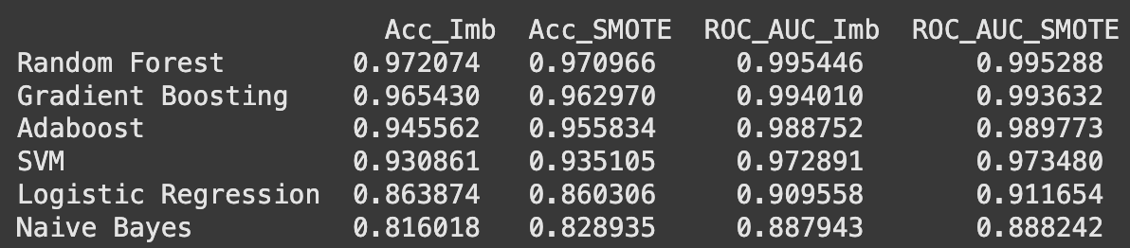
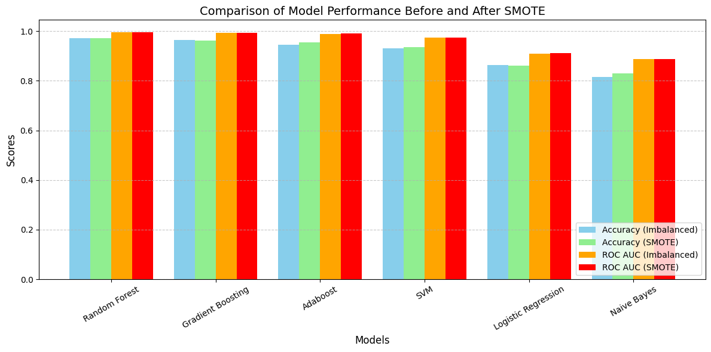
Comparison of Individual Models Before and After SMOTE on the basis of Highest ROC_AUC Score Post SMOTE
Comparison of Model Performance before and after SMOTE

Slide 19
Logistic Regression, SVM, Naive Bayes, and Adaboost performed better with SMOTE in terms of ROC AUC, which is an essential metric for imbalanced data because it captures the trade-off between true positive rate (TPR) and false positive rate (FPR).
Random Forest and Gradient Boosting did not benefit from SMOTE, likely because these models already have mechanisms to handle imbalanced data effectively (e.g., weighted splits and ensemble techniques).
Overall Performance: While SMOTE improved the ROC AUC for some models, it did not significantly benefit Random Forest, and in some cases, it even slightly decrease the performance. The Random Forest model after hyperparameter tuning already demonstrated good performance on the imbalanced dataset. Stacking provides a marginal increase in performance.
Robustness: Random Forest generally handles class imbalance better than many other models. Its internal mechanisms help to address the issue without the need for oversampling.
Interpretability: Random Forest models offer good interpretability compared to more complex ensemble techniques, such as Stacking. This can be beneficial for explaining model predictions to stakeholders.
Computational Cost: Avoid SMOTE unless strictly necessary. It increases the size of the dataset, which can lead to longer training times without guaranteed improvement in performance.
Tuning: Hyperparameter tuning has already been applied to the Random Forest, showing a potential for improvement over the base model.
In summary, the Random Forest model with hyperparameter tuning provides a good balance between performance, robustness, and computational efficiency for this imbalanced dataset.
Obsevations based upon the comparison

Slide 20


